Slide 1
IOT based prenatal supervision
BATCH MEMBERS
INTERNAL GUIDE

Slide 2
Abstract
The proposed project entails the implementation of Eradicating needless foetal mortality rate from the world by using IOT based monitoring system. In the proposed system, a product idea of a device named ‘Prega care’ is presented. Our device aims at performing health monitoring functions by providing a way of interaction between doctor and woman.
Mainly, we have worked for five parameters-Fetus movement, temperature, blood pressure, blood oxygen level and heart rate monitoring. Care of a woman while pregnancy is always a topic of concern. It’s obvious to note that if compared to the general people, the effective treatments and precautions should be provided to pregnant women.

Slide 3
Objective
To decrease the death rate of pregnant women in rural areas.
To provide 100% medical care for needy pregnant women.
To create Happy Child birth experience to a women by ensuring IOT based monitoring system.

Slide 4
Literature Review (latest year first)
S.No | Name of the authors | Journal name | Inference
1 | Fazal, N.; Webb, A.; Bangoura, J.; El Nasharty, M. Telehealth | Improving maternity services by modern technology | In this study, we first presented an IoT-based maternal monitoring system, providing services such as physical activity, sleep and stress monitoring throughout pregnancy and postpartum.
2 | Ritika, Anandhi Ramachandran | Wearable Sensors: A Step towards Smart Monitoring Of High Risk Pregnancies | proposed system vital health parameter such bp, body temperature, heart rate, fetus heart rate are analyzed and report will be generated which can be used for observation.

Slide 5
Literature Review
3. | Altini, Marco, et al. | Combining Electrohysterography and Heart Rate Data to Detect Labour | Regular monitoring of the vital parameters of fetus and women in the rural areas, reduces the infant mortality.
4. | J. Yadav, A. Rani, V. Singh and B. M. Murari | Near-infrared LEDbased non-invasive blood glucose sensor | characterizing various parameters such as uterine contractions, the Fetal Heart Rate (FHR), and the fetal
5. | E.Sadovsky, MD and H.Yaffe, MD | Daily FetalMovement Recording and Fetal Prognosis | our developed device would really help to lower the complications of expecting mothers by imposing a more reliable monitoring system.

Slide 6
Block Diagram
TEMPERATURE
SENSOR
BLOOD OXYGEN
LEVEL SENSOR
ARDUINO
UNO
MICRO
CONTROLLER
TO CLOUD
WIFI
MODULE
HEART RATE
SENSOR
ACCELEROMETER
(BABY MOVEMENT)
FROM CLOUD
MOBILE
DEVICE
APP
DEVELOPMENT
BLOOD
PRESSURE

Slide 7
Methodology
In our proposed system, the crucial parameters like heartbeat rate, blood oxygen level, blood pressure, temperature and movement are measured by the help of sensors.
The information from the sensors is stored in the cloud.
The data sent to cloud can be viewed on the mobile of doctors, the pregnant women, and her husband.
In case of fluctuations in the parameters of women from the normal, an alert will be sent to the doctor’s mobile application and the husband’s mobile application using Wifi.
DISTURBANCE

Slide 8
Methodology
Also, the real-time health parameters result will be displayed in the application.
The involvement of doctors will make this system more reliable for health monitoring.
The concern of the proposed work is to develop a device that can act as a helping hand and take care of the health of the women, especially for rural areas who can’t go for a regular check-up.
Also, a button will be provided in the device which when pressed sent a message alert or alarm indication on the phone of the neighbor or family members.
DISTURBANCE

Slide 9
Results and Discussion
The results of our project are as follows
Continuous monitoring of women’s health parameter is possible.
Can be used by women in remote locations.
Alert can be generated if any abnormailty occurs.
Mobile application to store data.
Due to continuous monitoring, small changes from the desired level can be monitored and alerted.
The panic butoon can be very helpful for women who are alone.
Thus a safe pregnancy journey for the mother and baby is assured in a cost efficient method.

Slide 10
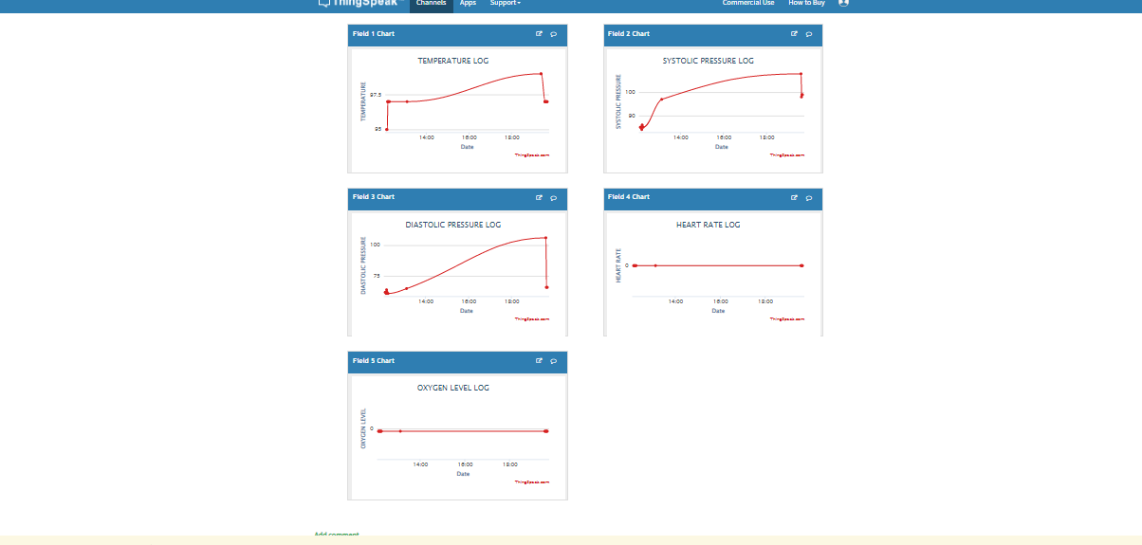
Output

Slide 11
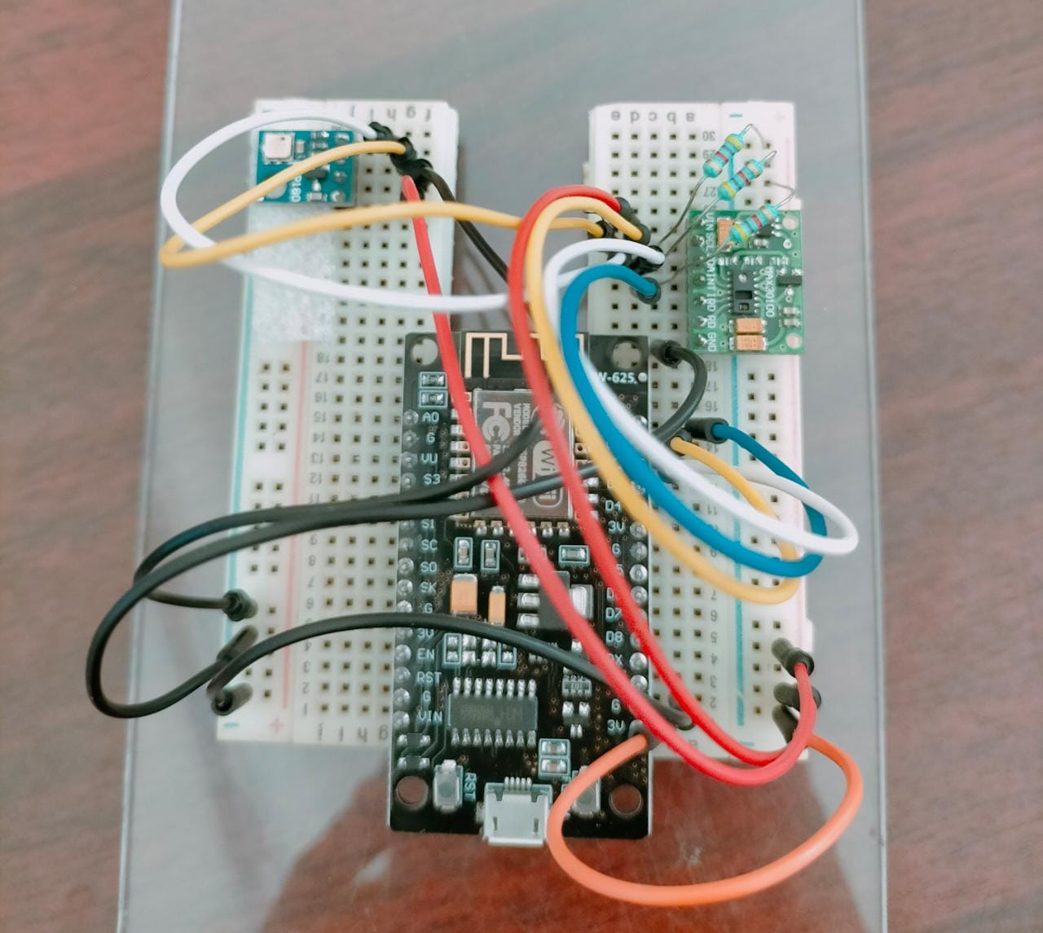
Circuit Connection

Slide 12
Future Work and Conclusion
As a future work we will add other health parameters like foetal heart rate, amniotic fluid clearness and diabetes.
We will also design an Android Application to display the data only to the doctor and husband of the pregnant women.

Slide 13
Milestone Activity
Month | Activity
January | literature & procurement of hardware components
February | Development and Implementation of hardware assembly
March | API interface with hardware
April | integration of hardware and API
End of April | validation and testing

Slide 14
Reference
Long-Term IoT-Based Maternal Monitoring: System Design and Evaluation Fatemeh Sarhaddi 1,* , Iman Azimi 1 , Sina Labbaf 2 , Hannakaisa Niela-Vilén 3 , Nikil Dutt 2 , Anna Axelin 3 , Pasi Liljeberg 1 and Amir M. Rahmani 2,4,5.
Designing for safety during pregnancy through a system for automotive engineers November 2004 ,9(6):625-631
Research with pregnant women: A call to action, Margaret Olivia Little and Marisha N. Wickremsinhe From Global Forum on Bioethics in Research (GFBR)’s “Ethics of Research in Pregnancy” meeting Buenos Aires, Argentina. 03-04 November 2016.
Mitchell AA, Gilboa SM, Werler MM, Kelley KE, Louik C, Hernández-Díaz S, Study NB. Medication use during pregnancy, with particular focus on prescription drugs: 1976-2008. Am J Obstet Gynecol. 2011;205(1):51–e1.
Little MO, Lyerly AD, Faden RR. Pregnant women & medical research: a moral imperative. Bioethica Forum. 2009;2(2):60–5.
Arduino CookBook, By Michael Margolis, O'Reilly Media, July 2014.
C Programming for Arduino by Julien Bayle, May 2013.

